Slide 1
If a person situated at the location P(-1,4,5) is looking at a surface that has vertices A(1,0,0), B(0,0,-1), C(-1,0,0) and D(0,0,1) will the surface be a back face

Slide 2
Illumination Models and Surface Rendering Methods
Realistic displays of a scene are obtained by
^{perspective projection}
applying natural light effects to the visible surfaces
Illumination model (lighting model) or shading model, is used to calculate the intensity of light that we should see at a given point on the surface of an object.
A surface rendering algorithm uses the intensity calculations from an illumination model to determine the light intensity calculation

Slide 3
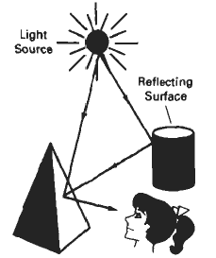

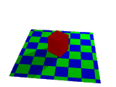
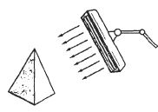

^{Light Sources}
Point source: tungsten filament bulb image can be seen
Distributed light source: fluorescent light
When light is incident on an opaque surface part reflected part absorbed. Surface that are rough or grainy tend to scatter reflected light in all direction is called diffuse reflection
Light sources create highlights or bright spots called specular-reflection.

Slide 4
^{Ambient light}
Ambient light surface directly not exposed directly but visible if nearby objects are illuminated
Combination of light reflections from various surfaces to produce a uniform illumination called the ambient light or background light(no shadow’s produced)
It has no spatial or direction characteristics and amount on each object is a constant for all surfaces and over all directions
^{I}_{am} ^{= k}_{a} ^{. I}_{a}

Slide 5

^{Diffuse Reflections}
Ambient light is an approximation of global diffuse, light effects .
Diffuse reflections are constant over each surface in a scene independent of viewing direction
^{k}_{d} or diffuse reflection coefficient or diffuse reflectivity (0 to 1)
^{k}_{d} is nearly 1 for highly reflective surface and k_{d} is 0 where light absorbs (black surfaces)
Diffuse reflection intensity at any point on the surface as
^{I}_{ambDiff} ^{= k}_{d} ^{. I}_{d}
^{Where I}_{ambDiff} is ambient light due to diffusion and Id is light due to diffusion
assuming diffuse reflections from the surface are scattered with equal intensity
in all directions independent of the

Slide 6
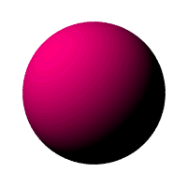
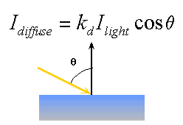
^{Diffuse Reflections}
Viewing direction (called “ideal diffuse reflectors”) also called Lambertian
reflectors and governed by Lambert’s Cosine Law.
If “angle of incidence” between incoming light direction and surface normal is 0
^{I}_{LDiff} ^{= k}_{d} ^{. I} _{L} ^{Cos Ө}
^{where I}_{LDiff} ^{is light due to diffusion}
If N is unit normal vector to a surface and L is unit direction vector to the point light source then
^{I}_{LDiff} ^{= k}_{d} ^{. I} _{L} ^{(N . L)}
In addition many graphics packages introduce an ambient reflection coefficient k_{d} to modify ambient light intensity k_{d}
then I_{Diff}(i.e. total) = ka . Ia + kd . I _{L} ^{(N . L)}

Slide 7
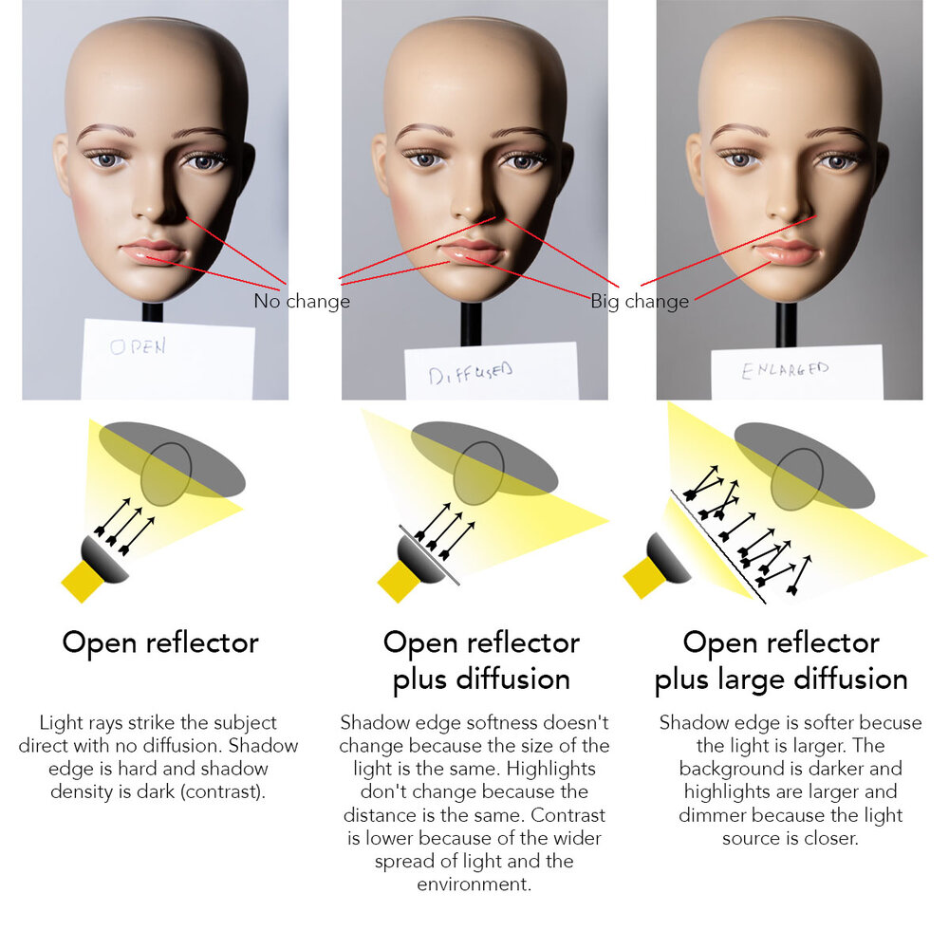

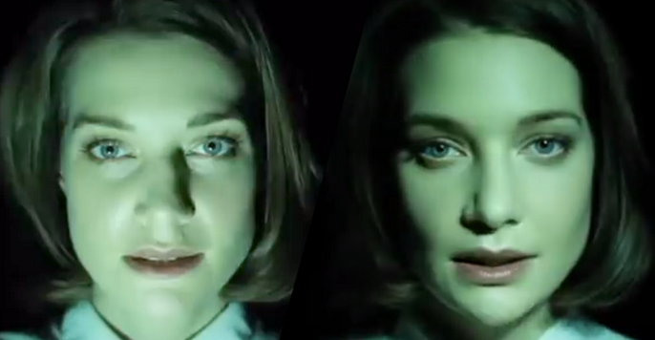

Slide 8
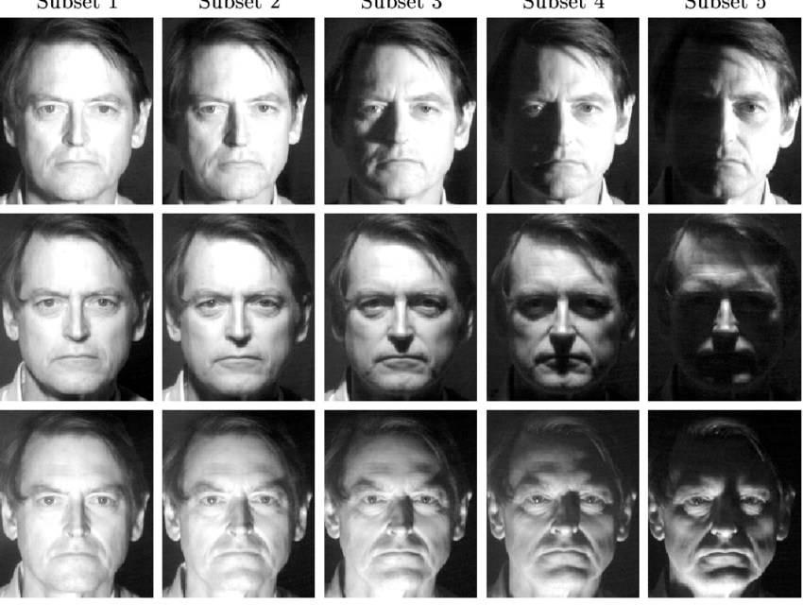

Slide 9
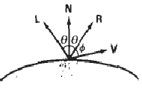
Specular Reflection/Phong Model
When we look at an illuminated shiny surface, such as polished metal, an apple etc we see a highlight or bright spot, at certain viewing direction this phenomenon is called “specular reflection”
It is the result of total or near total reflection of the incident light in a concentrated region around the “specular reflection angle”.
This angle is equal to the angle of incidence.
^{N – unit normal surface vector}
R – unit vector in the direction
^{of ideal specular reflection}
L – unit vector directed towards
^{point light source}
V – unit vector pointing to viewer
^{from the surface position}
^{Ø – viewing angle relative to}
specular reflection direction R

Slide 10
Specular Reflection/Phong Model
For monochromatic specular reflections intensity variations can be approximated by SR coefficient W(Ө)
W(Ө) tends to increase as Ө increases, at Ө = 90 W(Ө) = 1 and all incident light is reflected.
Fresnal’s law of reflection describes specular reflection intensity with Ө and suing W(Ө), Phong specular reflection model as
^{I}_{spec} ^{= W(Ө) I}_{L} ^{Cosns Ø where I}_{L} ^{is intensity of light source}
Ø is viewing angle relative to the specular reflection direction R.
So transparent materials like glass exhibit specular reflection as 0 approaches 90. At 0 = 0 about 4 percent of the incident light on a glass surface is reflected.
Now also I_{spec} ^{= W(Ø ) I}_{L} ^{( V . R )}
^{as} ^{V . R = Cosns Ø}

Slide 11
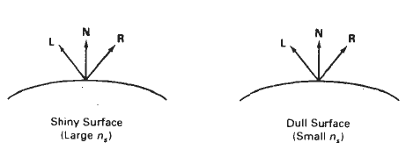
Specular Reflection/Phong Model
For ideal reflector (perfect mirror) incident light is reflected only in the specular reflection direction i.e. V and R coincide (Ø = 0 ).
Shiny surfaces have narrow Ø and dull surfaces have wider Ø
An empirical model for calculating specular reflection range was developed by Phong Bui Tuong called “Phong specular reflection” model and it sets the intensity of specular reflection directly proportional to
^{Cos ns Ø Ø → 0 to 90}
Specular reflection parameter n_{s} is determined by type of surface
Very shiny surface has large n_{s} ^{value}
Very dull surface has smaller n_{s} ^{value (down to 1)}
Rough surface, e.g. chalk has n_{s} ⁼ ¹
^{I}_{spec} ^{= W(Ө) I}_{L} ^{Cosns Ø}

Slide 12
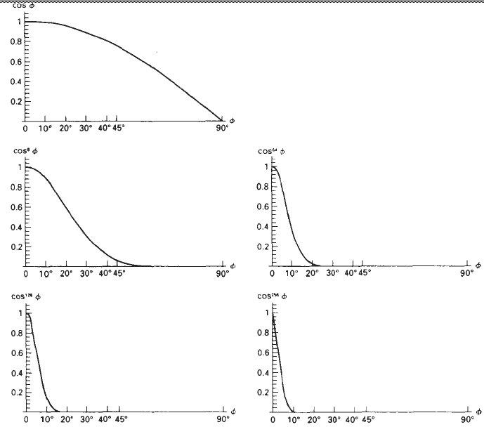
Specular Reflection/Phong Model
Intensity of specular reflection depends on material properties of surface, 0,other factors such as polarization , color of incident light.

Slide 13
Illumination Models and Surface Rendering Methods
Combined diffuse and specular reflections with multiple light sources
For single point light source
^{I = I}_{diffuse} ^{+ I}_{spec} ^{= K}_{a} ^{I}_{a} ⁺ ^{K}_{d} ^{I}_{L} ^{( N . L ) + K}_{s} ^{I}_{L} ^{( N . H ) ns}
For multiple light sources
^{I = K}_{a} ^{I}_{a} ^{+ ∑} ^{I}_{Li} ^{[ ( K}_{d} ^{( N . L}_{i} ^{) + K}_{s} ^{( N . H}_{i} ^{) ns ]}
^{i =1}

Slide 14



Ambient
Diffuse
Specular

Slide 15
A. Constant Intensity Shading (Flat Shading)
Fast and simple method for rendering of an object with polygon surfaces in CIS also called Flat Shading
Single intensity calculated for each polygon and useful for quickly displaying the general appearance of curved surface

Slide 16
This method is accurate if :
The object is a polyhedron and is not an approximation of an object with a curved surface
All light sources illuminating the object are sufficiently far from the surface
The viewing position is sufficiently far from the surface so that V.R is constant over the surface
Even if all conditions are not true, we can still reasonable approximate surface lighting effects using small polygon facets with flat shading and calculate the intensity for each facet at the center of the polygon.

Slide 17
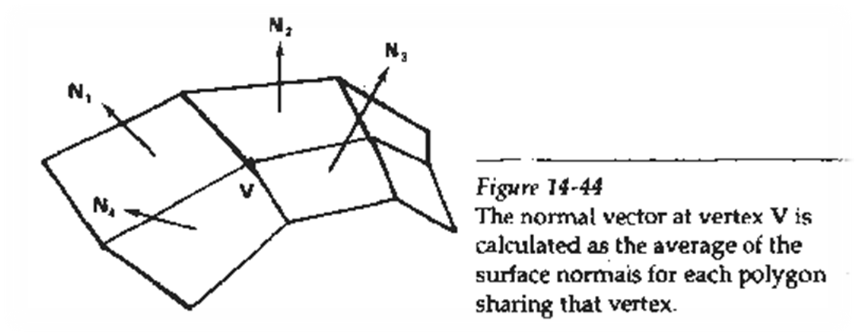
B. Gouraud Shading
Intensity interpolation scheme developed by Gouraud Renders a polygon surface by linearly interpolating intensity values across the surface
Intensity values for each polygon are matched with the values of the adjacent polygon along the common edge thus eliminating the intensity discontinuities occur in “flat shading”

Slide 18
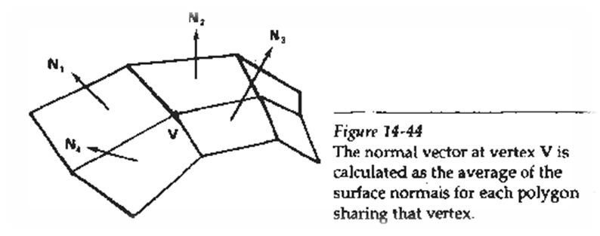
Calculation for each polygon surfaces
- Determine the average unit normal vector at each polygon vertex.
- Apply an illumination model to each vertex to calculate the vertex intensity
- Linearly interpolate the vertex intensities over the surface of the polygon
N₁ normal to ABCD plane , N₂ normal to CDEF plane and so on .

Slide 19
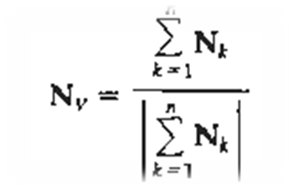
For any vertex position V normal unit vector once N_{v} is known intensity at vertices can be obtained from lighting model
Average unit normal vector at a vertex are computed by taking the average of the normals of the neighboring faces. The resulting normal is a unit normal, the averaging is done by summing all the neighboring normals, and dividing it by the magnitude of this sum.

Slide 20
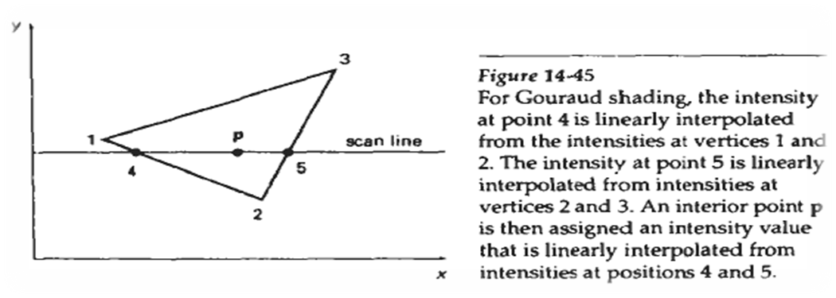
Next step:
Interpolating intensities along polygon edges
Fast method to find intensity at 4 using 1 and 2 using only vertical displacement
I₄ = y₄ - y₂ . I₁ + y₁ - y₄ . I₂ y₁ - y₂ y₁ - y₂
Similar process for I₅, using 3 and 2

Slide 21
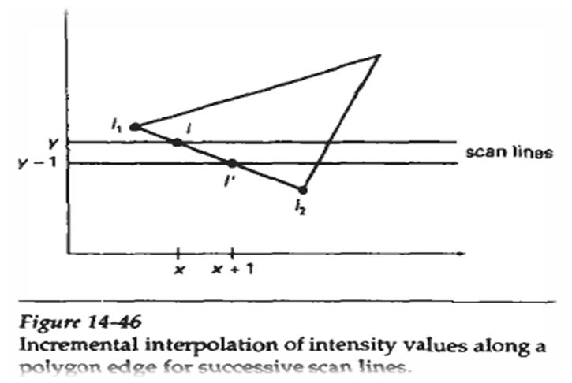

For interior point ‘p’ interpolated from the bounding intensities at point 4 & 5
I_{p} = x₅ - x_{p} . I₄ + x_{p} - x₄ . I₅ x₅ - x₄ x₅ - x₄
Easier than this is incremental calculations for successive edge intensity values
I = y - y₂ . I₁ + y₁ - y . I₂ y₁ - y₂ y₁ - y₂ for next scan line y - 1
I’ = I + I₂ – I₁ y₁ - y₂

Slide 22
Advantages:
- Removes discontinuities of intensity at the edge compared to constant shading model
Disadvantages:
- Highlights on the surface are sometimes displayed with anomalous shapes and linear intensity
- Interpolation can cause bright or dark intensity streaks called Mach Bands to appear on the surfaces.
Mach bands can be reduced by
- Dividing surface into a greater number of polygon faces
- Use Phong shading (requires more calculation)

Slide 23
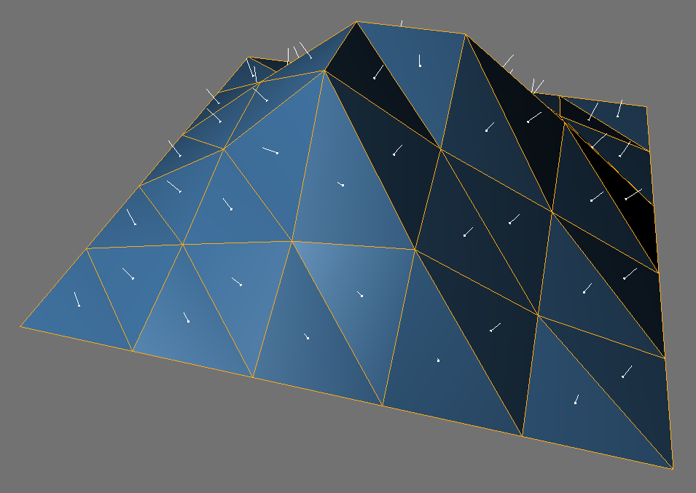
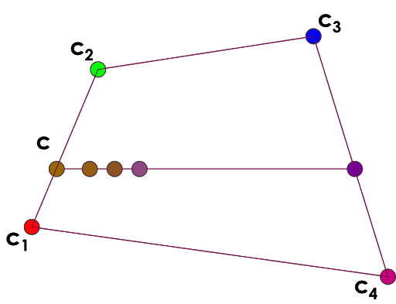

Slide 24
C. Phong Shading
More accurate method for rendering a polygon surface is to interpolate normal vector and then apply the illumination model to each surface point called “Phong Shading” or “Normal Vector Interpolation Shading”.
It displays more realistic highlights on a surface
Greatly reduces Mach band effect.

Slide 25
Steps:
- Determine the average unit vector normal at each polygon vertex
- Linearly interpolate the vertex normal over polygon surface
- Apply an illumination model along each scan line to calculate projected pixel intensities for the surface points

Slide 26
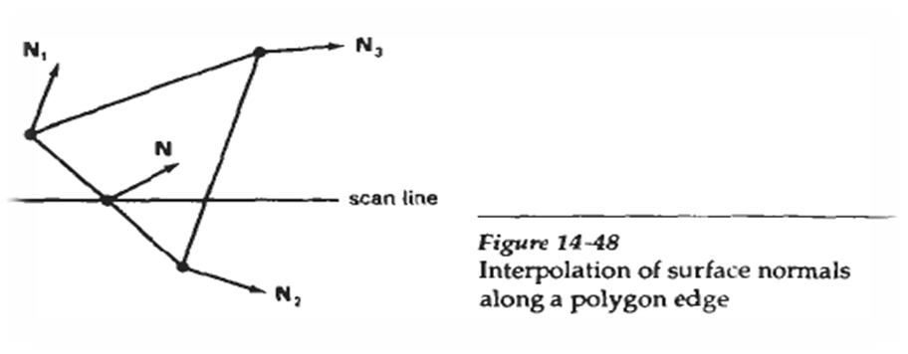
N can be obtained by vertically interpolating between edge end point normal (N₁ and N₂)
N = y - y₂ . N₁ + y₁ - y . N₂ y₁ - y₂ y₁ - y₂

Slide 27
Incremental methods are used to evaluate normal between scan lines and along each individual scan line (as in Gouraud) at each pixel position along a scan line the illumination model is applied to determine the surface intensity at that point
Produces accurate results than the direct interpolation but it requires considerable more calculations

Slide 28
Fast Phong Shading (FPS)
FPS approximates the intensity calculations using a Taylor series expansion and triangular surface patches
Surface normal at any point (x,y) over a triangle as N = Ax + By + C
A,B,C are determined from three vertex equations N_{k}= Ax_{k} + By_{k} + C …. k = 1,2,3 (x_{k},y_{k} vertex position)
Omitting reflexivity and attenuation parameters
Notes:
Tylor series : approximate function as a series of linear or quadratic forms, and then successively iterate on them to find the optimal value.

Slide 29
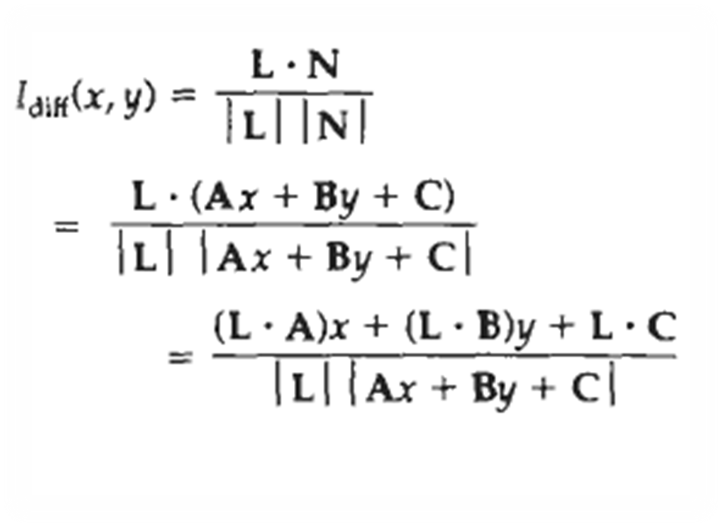

Slide 30
Performing the indicated dot products and expanding the vector magnitude yields:
We can write
I_{diff} (x,y) = ax + by + c ………….(i)
(dx² + exy + fy² + gx + hy + i) ^{½}
Where a,b,c,d are used to represent the various dot products e.g. a = L . A
| L |

Slide 31
Finally denominator in eq(i) can be expressed as Taylor series expansion and retain terms up to second degree in x and y. This yields
I_{diff} (x,y) = T₅x² + T₄xy + T₃y² + T₂x + T₁y + T₀ ……………..(ii)

Slide 32
Fast Phong Shading is two times slower than Gouraoud shading
Normal Phong shading is 7 times slower than Gouraud
Fast Phong Shading can be extended to include specular reflections

Slide 33
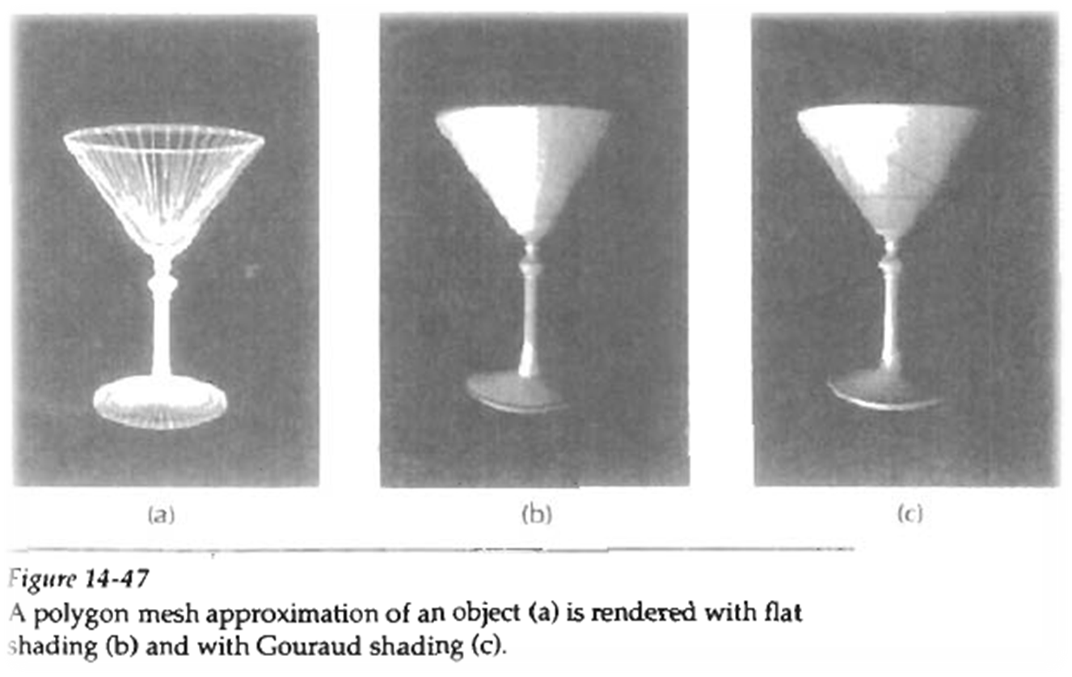

Slide 34
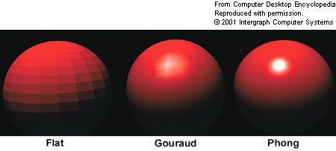

Slide 35
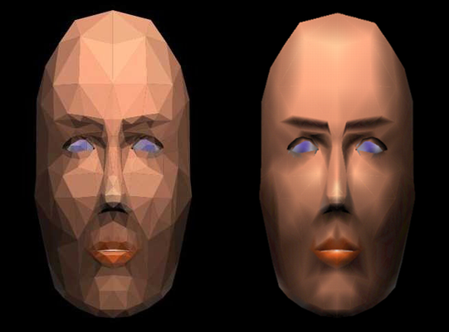

Slide 36


A rectangle plane has vertices A(0,0), B(8,0), C(8,8), D(0,8), find the reflected intensity at point P(4,4) using Gouraud Shading technique.
The average intensities of reflected illumination at the four vertices are : I_{A} = 6, I_{B} = 8, I_{C} = 3, I_{D} = 5
I4= (-4)/(-8)X 5 + (- 4)/(-8)X6 = 2.5+3= 5.5
D
C
4
A
B

